Slide 1


Linear Data in Data Mining: An Introduction
This presentation covers linear data mining techniques. Linear data has specific characteristics. We will explore the importance of analyzing it. This includes time series data and sensor readings. We will look at various linear techniques, which are building blocks for non-linear models.
by Karthigeyan NS

Slide 2
Linear Regression: Modeling Linear Relationships
Linear regression is a predictive modeling technique. Ordinary Least Squares estimates the parameters. The equation is: y = b0 + b1*x1 + ... + bn*xn.
Example: Predicting House Prices
Evaluation Metrics
Predict house prices based on square footage. Use the number of bedrooms and location. Zillow's data shows strong correlation.
R-squared
Mean Squared Error (MSE)
Root Mean Squared Error (RMSE)

Slide 3



Support Vector Machines (SVM): Linear Classification
SVM classifies linearly separable data. The goal is to maximize margin and support vectors. The hinge loss function is used. Kernel methods handle non-linear data.
Classifying Emails
Accuracy
Classify emails as spam or not spam. This is based on word frequency.
SVMs achieve 92% accuracy on the Spambase dataset.

Slide 4
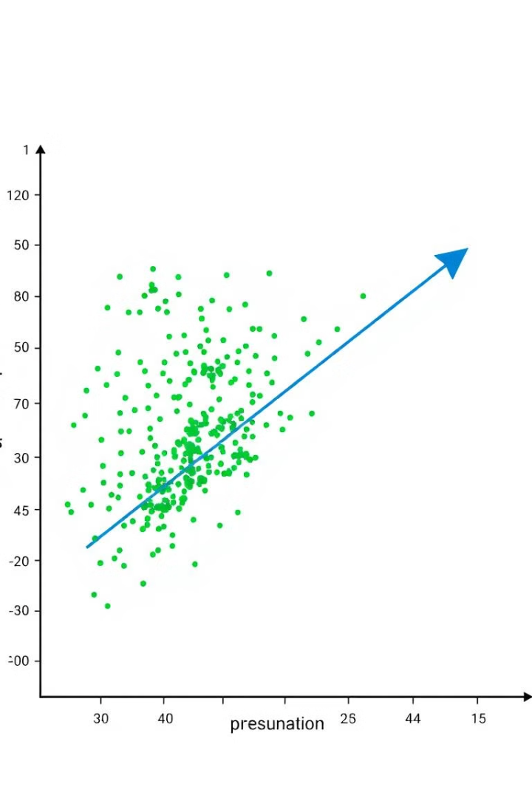
Principal Component Analysis (PCA): Linear Dimensionality Reduction
PCA reduces dimensionality while preserving variance. The steps involve standardization. Calculate the covariance matrix and eigenvalue decomposition. Then select principal components.
Gene Expression Dataset
Variance Explained
80% variance explained with first 10 components.
Reduce features in a gene expression dataset.
Applications
Noise reduction
Feature extraction
Data visualization

Slide 5
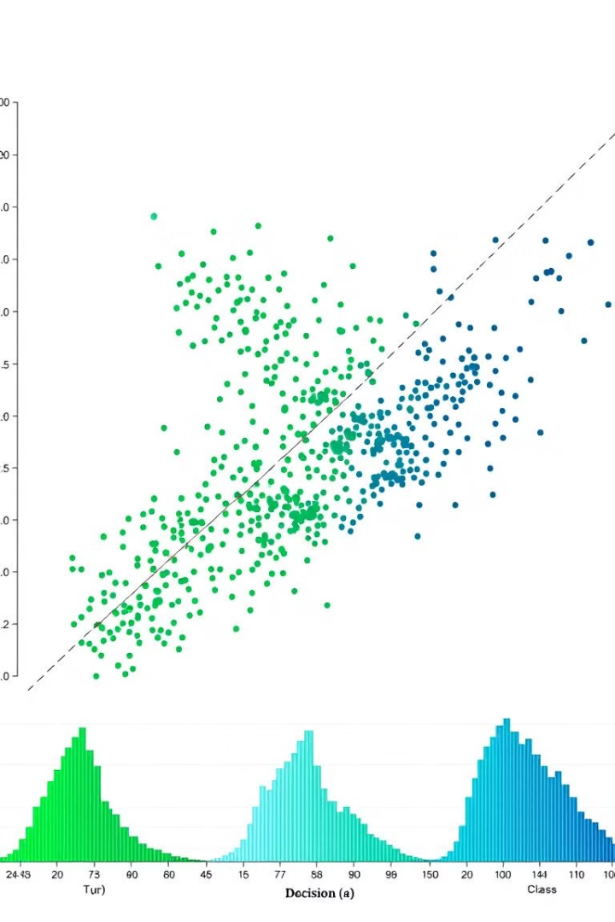



Linear Discriminant Analysis (LDA): Supervised Linear Transformation
LDA maximizes class separability in labeled data. It calculates between-class and within-class scatter matrices. Then it performs eigenvalue decomposition.
Customer Segmentation
Segment customers based on demographics and purchasing behavior.
Improved Accuracy
LDA improved classification accuracy by 15%.
Applications
Pattern recognition
Bioinformatics
Marketing

Slide 6



Limitations of Linear Methods
Linear methods can't model complex, non-linear relationships. They are sensitive to outliers and noisy data. The linearity assumption may not hold. Data preprocessing and feature scaling are needed.
2
Stock Market Data
1
Cyclical Patterns
2008 Financial Crisis
3

Slide 7

Conclusion: The Power and Pitfalls of Linearity
Linear techniques have many applications. It's important to understand data characteristics. Future directions involve combining linear and non-linear techniques.
Advanced Techniques
Underlying Structure
Explore advanced data mining techniques.
Consider the data's underlying structure.

